Slide 1
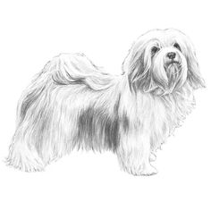
DIAMOND PETS
GROOMING

